Slide 1

Workspace branding

Slide 2
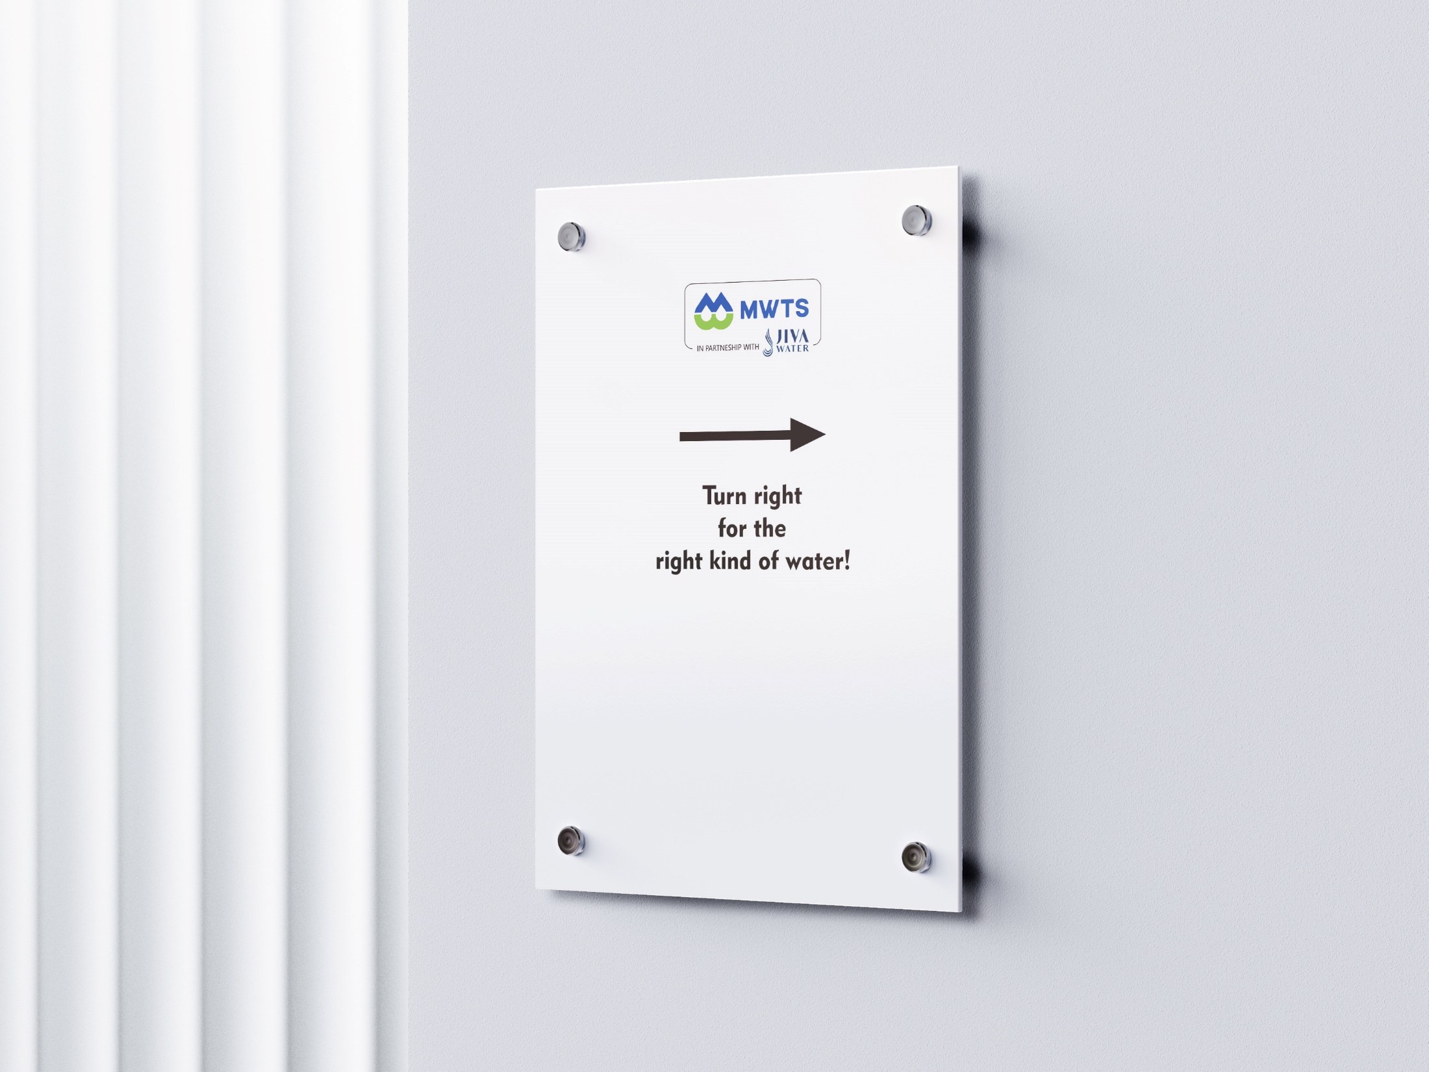

Pathway Branding

Slide 3

Pathway Branding

Slide 4
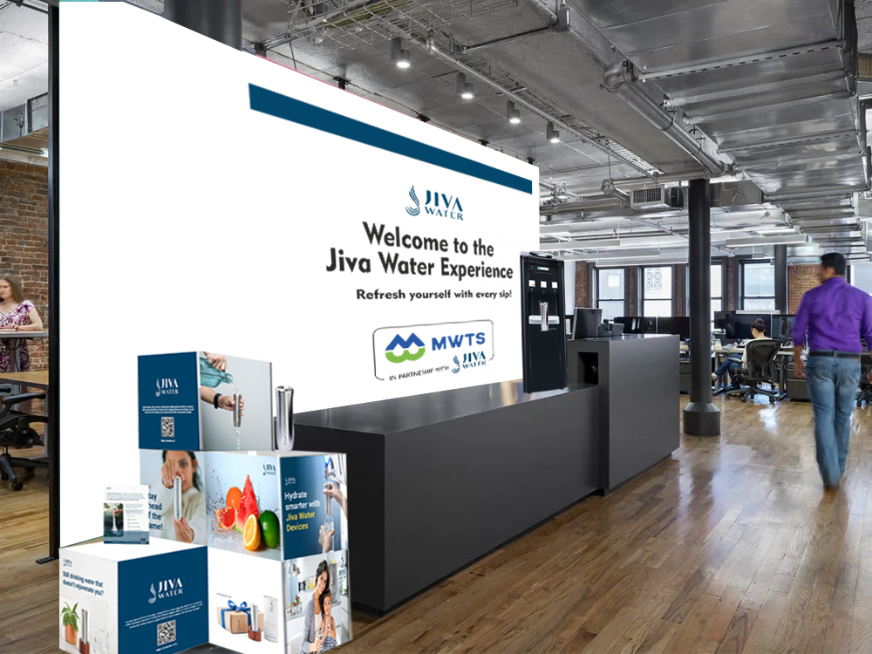
Dining space Branding

